Slide 1

BLOCKCHAIN
Sunitha R
Department of Computer Science Engineering

Slide 2

BLOCKCHAIN
Cryptography for Blockchain
Sunitha R
Department of Computer Science Engineering

Slide 3
BLOCKCHAIN
Learning Content
Learn and Apply the blockchain for various application to provide secure way of data access using cryptographic functions.

Slide 4
BLOCKCHAIN
Cryptography
“crypt-" means "hidden" or "vault"
“graphy" stands for "writing.“
Cryptography
Cryptanalysis

Slide 5
BLOCKCHAIN
Cryptography for Blockchain
Cryptography is the study and practice of keeping secret information away from adversaries.
Bitcoin was initially proposed as a cryptography-based currency that could avoid the downsides of having a financial system controlled by central institutions.
The idea of transferring value through a chain of digital signatures, which are like handwritten signatures

Slide 6
BLOCKCHAIN
History
The word "cryptography" is derived from the Greek kryptos, meaning hidden.
The origin of cryptography is usually dated from about 2000 B.C., with the Egyptian practice of hieroglyphics.
The first known use of a modern cipher was by Julius Caesar (100 B.C. to 44 B.C.), who did not trust his messengers when communicating with his governors and officers.
So, he created a system in which each character in his messages was replaced by a character three positions ahead of it in the Roman alphabet.

Slide 7
BLOCKCHAIN
Cryptographic Key Components
Plaintext
Encryption
Ciphers
Ciphertext
Decryption
Notes:
Blockchain technology has come a long way since the initial vision published by Satoshi Nakamoto in the Bitcoin white paper in 2008.
The author, Satoshi Nakamoto wanted to create a peer-to-peer electronic cash system that did not need a network of banks to operate.
Satoshi described “blocks” and “chains” as a way of organizing and securing records, such that once entries had been made into a shared database, they could be proved mathematically correct and to have remained unchanged.
Blockchain software becomes the trusted record-keeping systems, and the rules programed into the software become the intermediaries.
It is important to note that blockchains can be used for more than just recording the transfer of value between two parties.
The primary benefits of cryptographic identity, historical and chronological provenance, and the transparency of the networks complete history work exceptionally well for many industries that require two parties to trust each other.

Slide 8
BLOCKCHAIN
Process
Plaintext
Encryption
Ciphertext
Decryption
Plaintext
Readable format non encoded data
Non-readable format encoded data
Readable format non encoded data

Slide 9
BLOCKCHAIN
Objectives
Confidentiality
Non-repudiation
Integrity
Authentication
Notes:
Confidentiality: the information cannot be understood by anyone for whom it was unintended
Integrity: the information cannot be altered in storage or transit between sender and intended receiver without the alteration being detected
Non-repudiation: the creator/sender of the information cannot deny at a later stage his or her intentions in the creation or transmission of the information
Authentication: the sender and receiver can confirm each other's identity and the origin/destination of the information

Slide 10
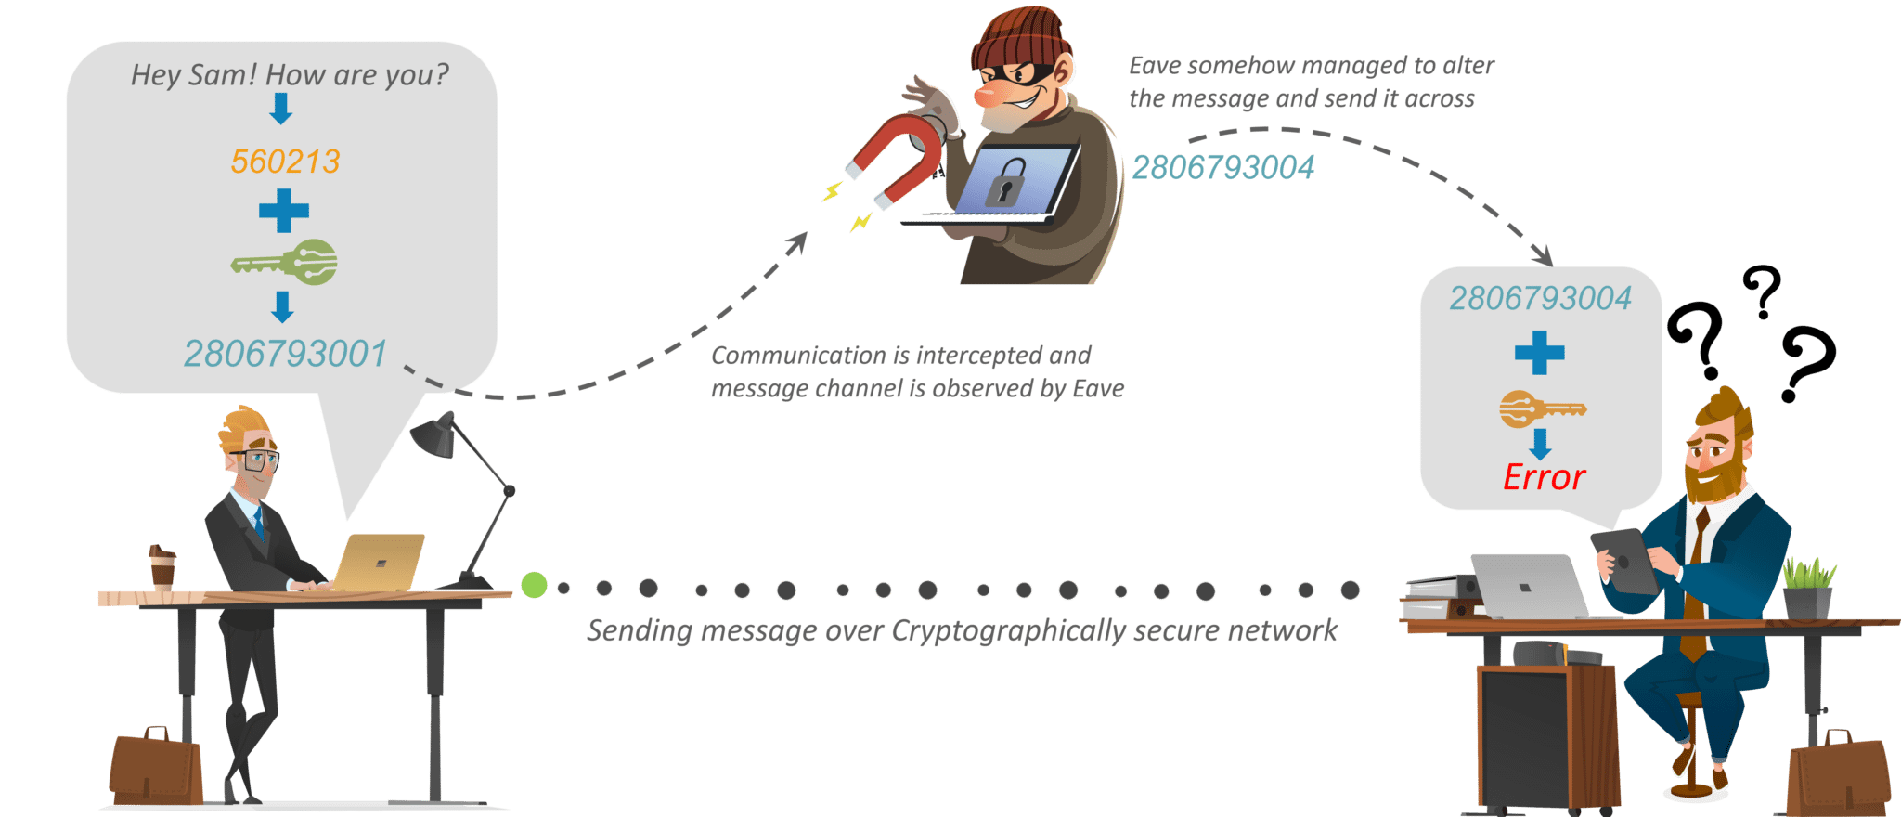
BLOCKCHAIN
Vulnerability

Slide 11
BLOCKCHAIN
Keys
Private Key
Public Key

Slide 12
BLOCKCHAIN
Supplementary readings
https://tools.ietf.org/html/rfc3447
https://ieeexplore.ieee.org/document/8946277
https://ieeexplore.ieee.org/document/8663738

Slide 13
THANK YOU
Sunitha R
Department of Computer Science Engineering
sunithar@pes.edu
+91 80 6666 3333 Extn 721

